Slide 1
DIGITAL BOARD MARKER (Storage Efficient System for Class Lectures)
Advisor:
Mr. Samyan Qayyum Wahla
Group Members:
Muhammad Haris Khan [2016-CS-105]
Hamza Farooq [2016-CS-122]
Ayesha Atif [2016-CS-152]
Komal Shehzadi [2016-CS-178]

Slide 2
Agenda
Introduction
Project Overview
Demo Video
General Flow
Motivation
Problem Statement
Scope
Application Areas
Literature Survey
Methodology
Results
Future Work

Slide 3




Project Overview
Storage Efficient System
Complete LMS
Bandwidth Efficient System
Offline Player

Slide 4
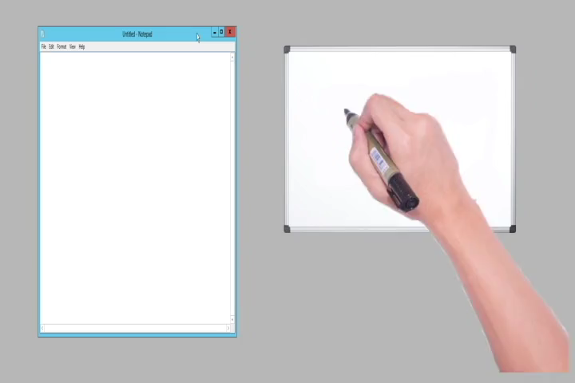
Project Overview(Contd.)

Slide 5








Open the controller app and press the ‘Start’ Button.
Start the lecture as lecture recording is started.
At the end of lecture, press ‘END’ button on controller application.
General Flow
Play and enjoy the lecture.
Want to listen the lecture!
Open web application to view lecture list.
Lecture saved and uploaded on web application.

Slide 6

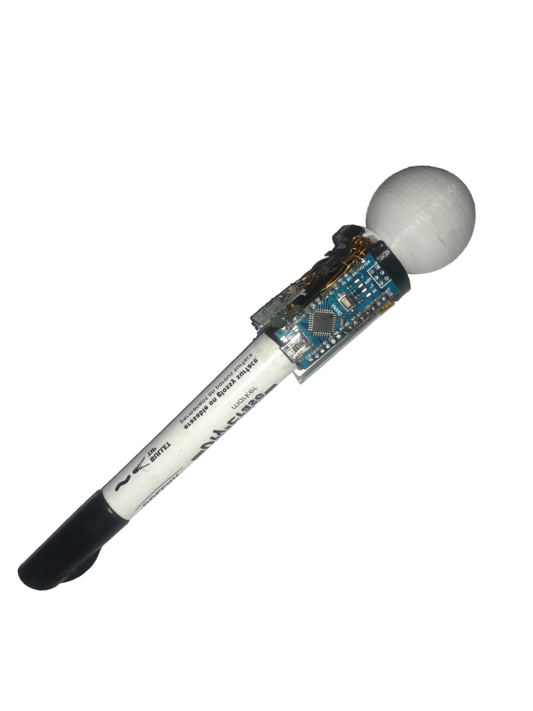




Motivation
Minimizing Resources
Difficulty in writing Notes as well as listening and understanding
Less bandwidth usage
Less storage
Play without internet

Slide 7
Problem Statement
“To make a storage and bandwidth efficient system with a lecture player and learning management system for the students and the educational institutes.”

Slide 8
Scope
The proposed system will:
Record lecture with two stereo vision cameras frame rate 60 FPS.
Create Video Player that can animate.
Record voice and board marker position data using custom developed wireless modules.
Use a whiteboard of dimension 4x3 ft.

Slide 9




Application Areas
Educational Institutes
DBM
Applications
Industrial Presentations
Sketch Artists
Online Tutors

Slide 10
Comparison With Existing Systems
Initiative | Storage Space per sec | Customized file format | Dedicated Player
Edx | 793.6 KB | MP4, AVI | YouTube
Moodle | 720 KB | MP4, AVI | YouTube
Coursera | 750 KB | MP4, AVI | Custom
Udemy | 790 KB | MP4, AVI | YouTube
Udacity | 790 KB | MP4, AVI | YouTube
DBM | 14.5 KB | Custom dbm format | Json based
Animation File Size = 226 kb
Animation File Duration = x = 47 sec
Size per second = 226/47 = 4.8 kb/sec
Audio File Size = 600 kb
Audio File Duration = y = 60 sec
Size per Second = 600/60 = 10 kb
Final file Size = x + y = 4.8 + 10 = 14.8 kb/sec

Slide 11



Technologies
Angular 8 (Frontend)
.NET Core (Web API)
Windows form (Controller
Application)

Slide 12
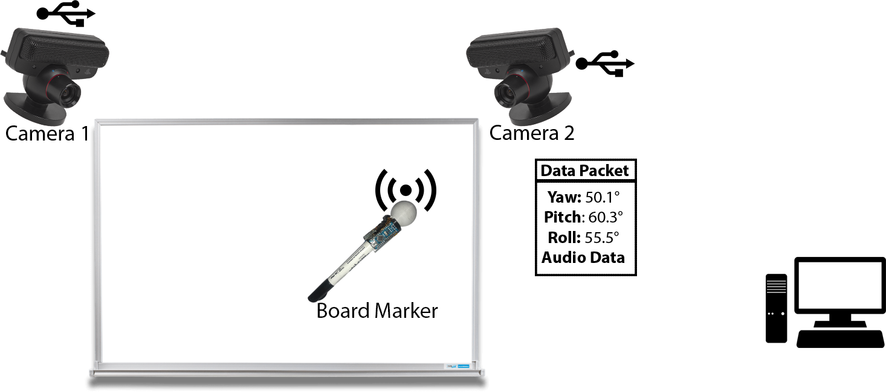
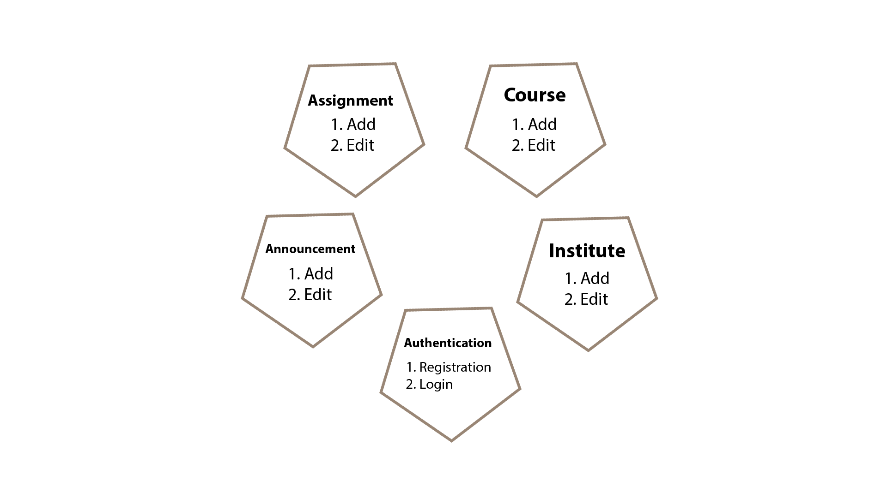
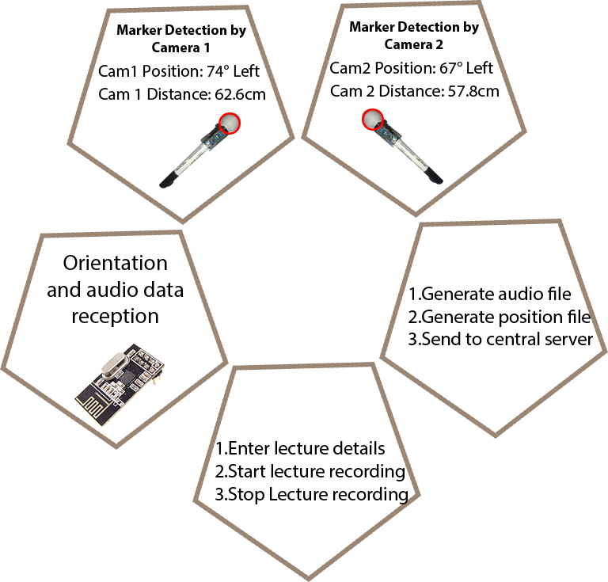
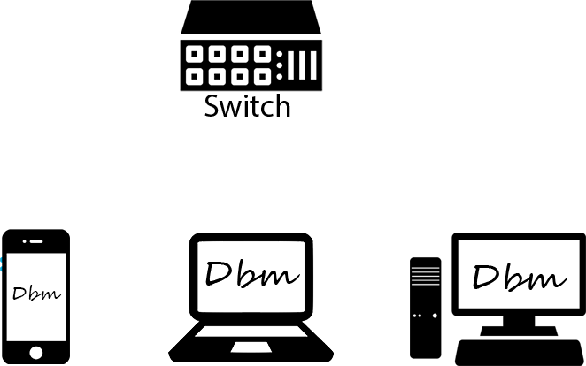

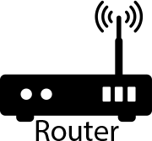

Methodology

Slide 13
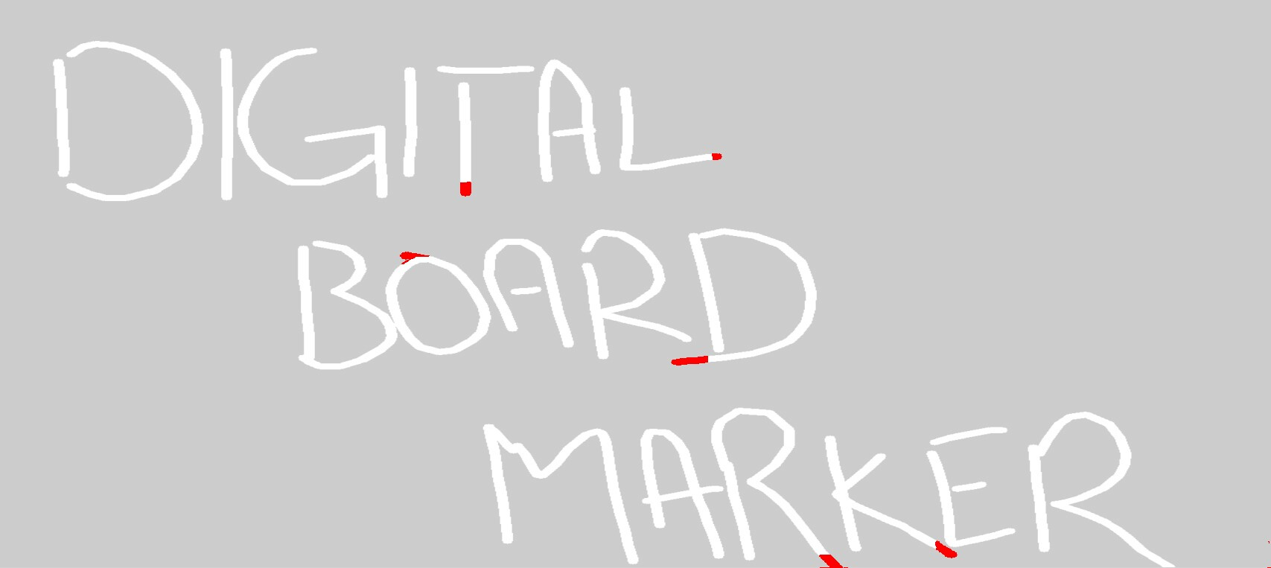
Results

Slide 14
Future Work
A web GL player for online running of file
Integrating audio module
Use ordinary board marker
Increase in board dimensions
Automatic notes generation

Slide 15
Thank You

